Slide 1
Mechanisms of disease in the antiphospholipid syndrome
by
Nunzio Bottini, MD, PhD
A short tributededicated to the memory of Dr. Virgil Woods Jr.: brilliant and generous scientist, dedicated mentor, and truly compassionate physician
Illustrations and tables from: Meroni PL et al, Nature Rev Rheumatol, 7:330-339, 2011

Slide 2
Remembering an exceptional collaborator and mentor
I met Dr. Woods in 2009, when I proposed a scientific collaboration aimed at finding powerful inhibitors of a molecule that is involved in causation of autoimmune diseases
Dr. Woods enthusiastically accepted to help me, and we published a paper in less than 1y!
Himself a physician scientist, Dr. Woods was very supportive of my desire to become a clinical fellow
In 2011 I had the pleasure to work with Dr. Woods in Hillcrest clinic on Wednesdays

Slide 3
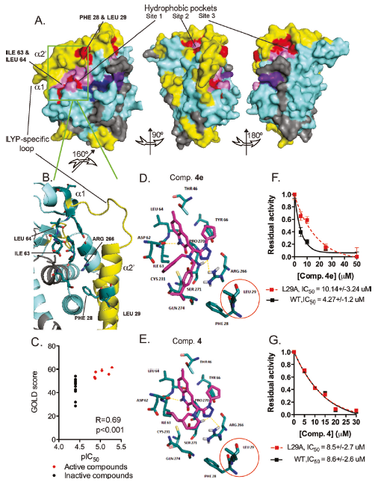
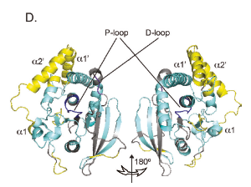
Using Dr. Woods’ DX-MS we could identify the areas of the protein that are affected by inhibitor binding. And we successfully model the interaction between the inhibitor and the protein.

Slide 4
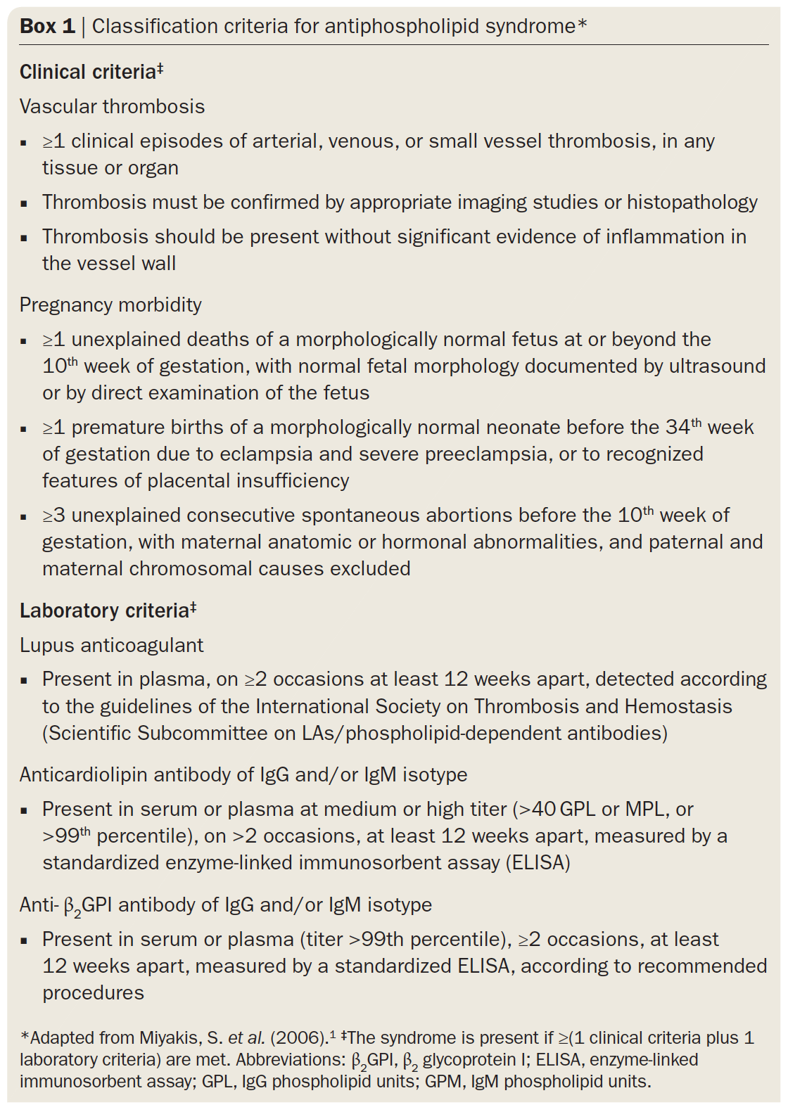
Antiphospholipid syndrome
Autoimmune syndrome characterized by excessive blood clotting and pregnancy problems, can be life threatening
Characterized by the presence of special antibodies in circulation called antiphospholipid (APL) antibodies
The serum of the patients can display a characteristic and paradoxical coagulation defect
The most commonly used phospholipid used in diagnostic assays for APL antibodies is called cardiolipin

Slide 5
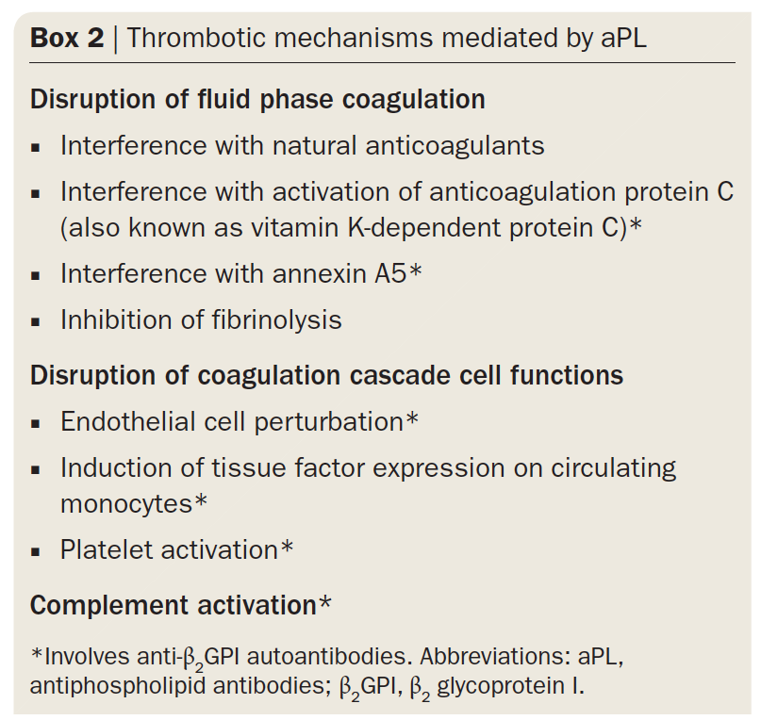
Mechanisms of excessive clotting
Multiple mechanisms have been proposed to explain why APL antibodies cause clotting, including effects on coagulation or anticoagulation factors, on platelets, on the cells that line the vessels, on white blood cells, and on complement (an antibacterial pro-inflammatory cascade of proteins that can also affect coagulation).

Slide 6
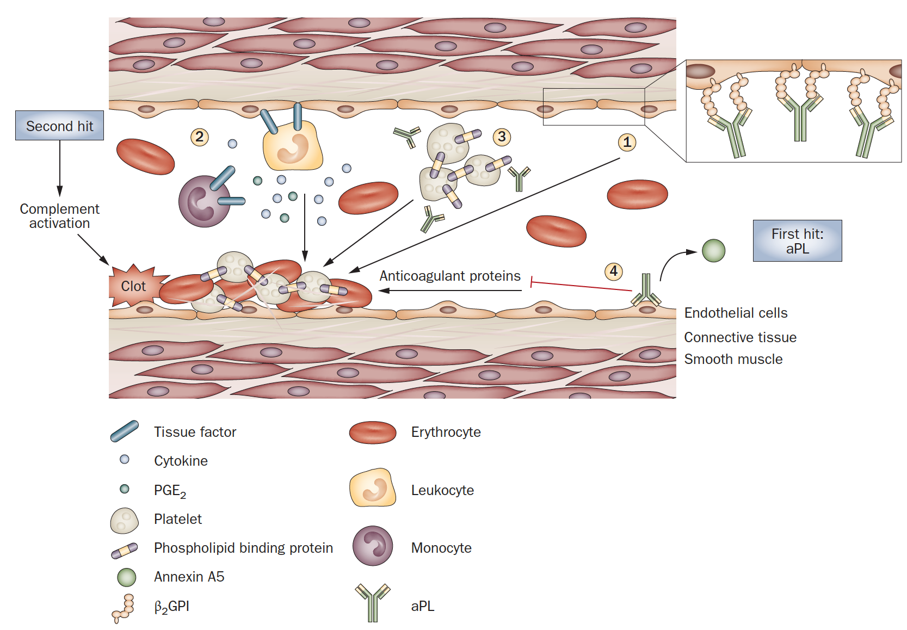
Mechanisms of excessive clotting
APL antibodies can bind to the surface of the vessel-lining cells and induce a dysfunction of these cells that makes them more prone to trigger blood coagulation

Slide 7
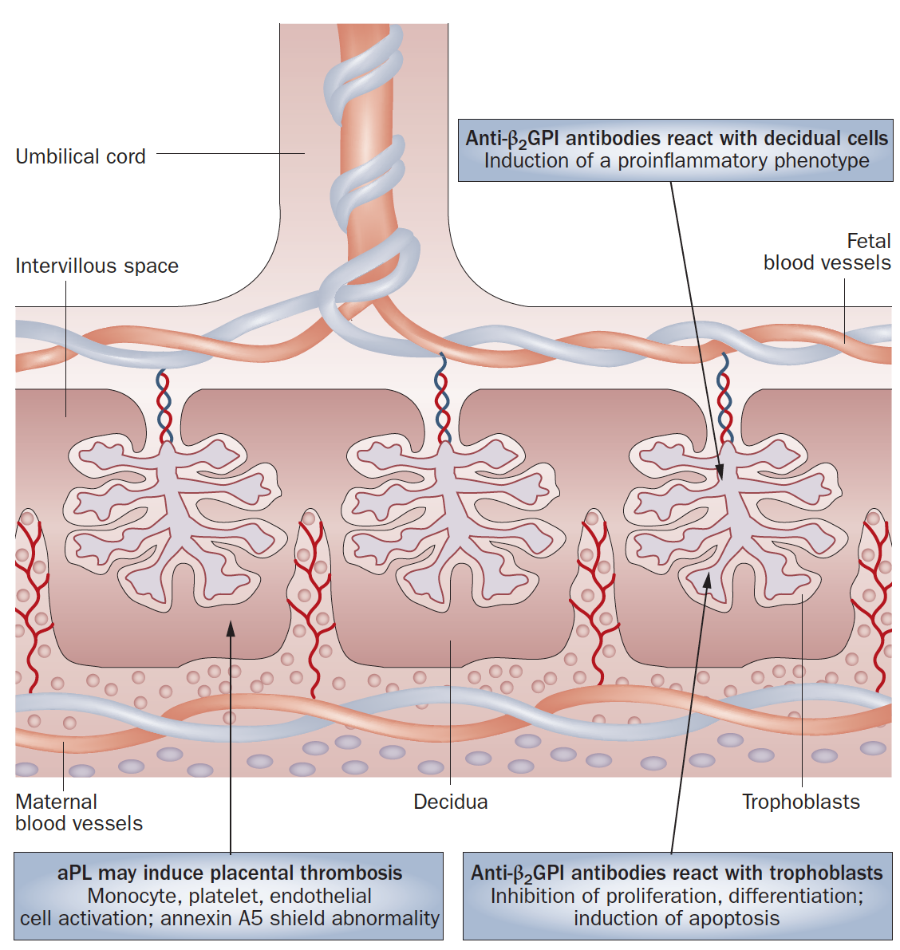
Mechanism of pregnancy complications
The easiest hypothesis is that the APL antibodies cause clots in the placenta but there is not much evidence in support of this mechanism
Binding of APL antibodies to the placental cells that are deputed to nourish the embryo/fetus causes dysfunction of these cells
Binding of APL to the lining of the vessels of the placenta induces inflammation which in turn causes placental dysfunction

Slide 8
Antiphospholipid antibodies
Anti-cardiolipin antibodies include mostly antibodies directed against a protein called beta2GPI. The antibodies can bind beta2GPI alone or when in complex with phospholipids
Beta2GPI is so important as a target of APL antibodies that testing for anti-beta2GPI antibodies is now part of the standard diagnostic approach to APL syndrome

Slide 9
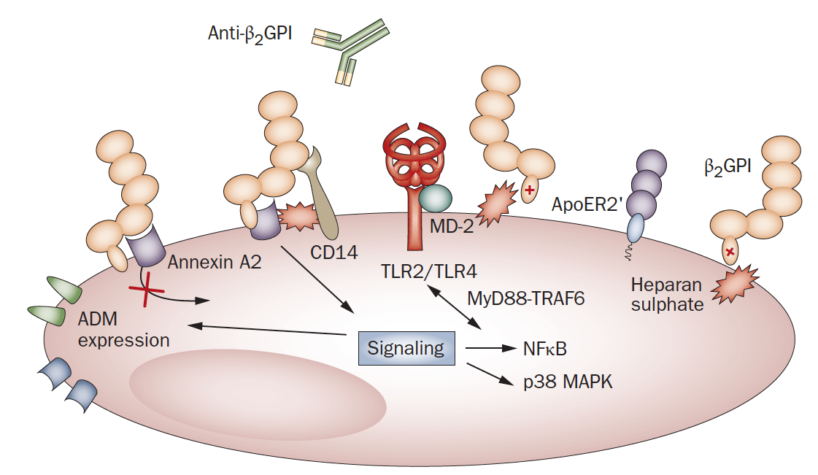
Anti-beta2GPI and clotting
Beta2-GPI can bind to the cells that line the blood vessels
The mechanism of the binding is still unclear
Receptors for bacterial products might be involved
That would explain some observations pointing to infections as a necessary “second hit” in order to trigger the clotting phenomenon

Slide 10
Mechanism of excessive clotting
The second hit necessary to trigger clotting might also act through a pro-inflammatory action, for example by activating the complement cascade
However no second hit is required to cause the pregnancy complications

Slide 11
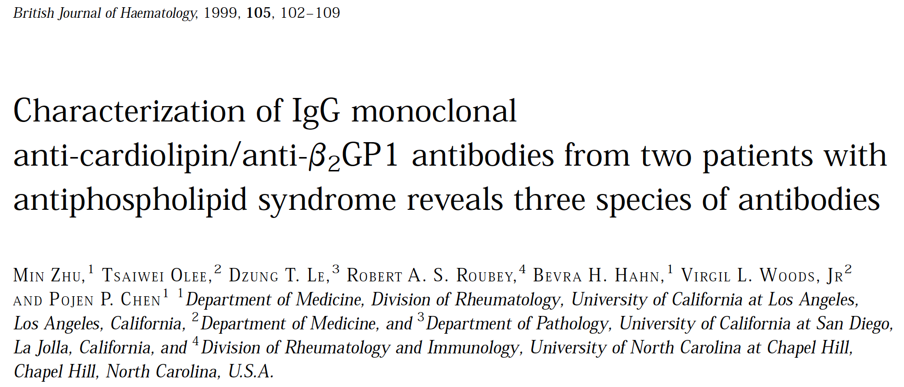
This study showed that there are three classes of anticardiolipin antibodies
The ones that bind only bovine beta2GPI but not human beta2GPI
The ones that bind both complexes of beta2GPI and cardiolipin and beta2GPI alone
The ones that only bind complexes of beta2GPI and cardiolipin
In general anti-beta2GPI antibodies did not cause coagulation anomalies when added to normal serum

Slide 12
Antiphospholipid antibodies
Many antibodies that are able to cause the coagulation anomalies when added to normal serum were found to be directed against the precursor of an important protein that is at the origin of the coagulation cascade, called prothrombin.
It was found that prothrombin can bind phospholipids and is present in preparations of phospholipids used for diagnosis of APL

Slide 13
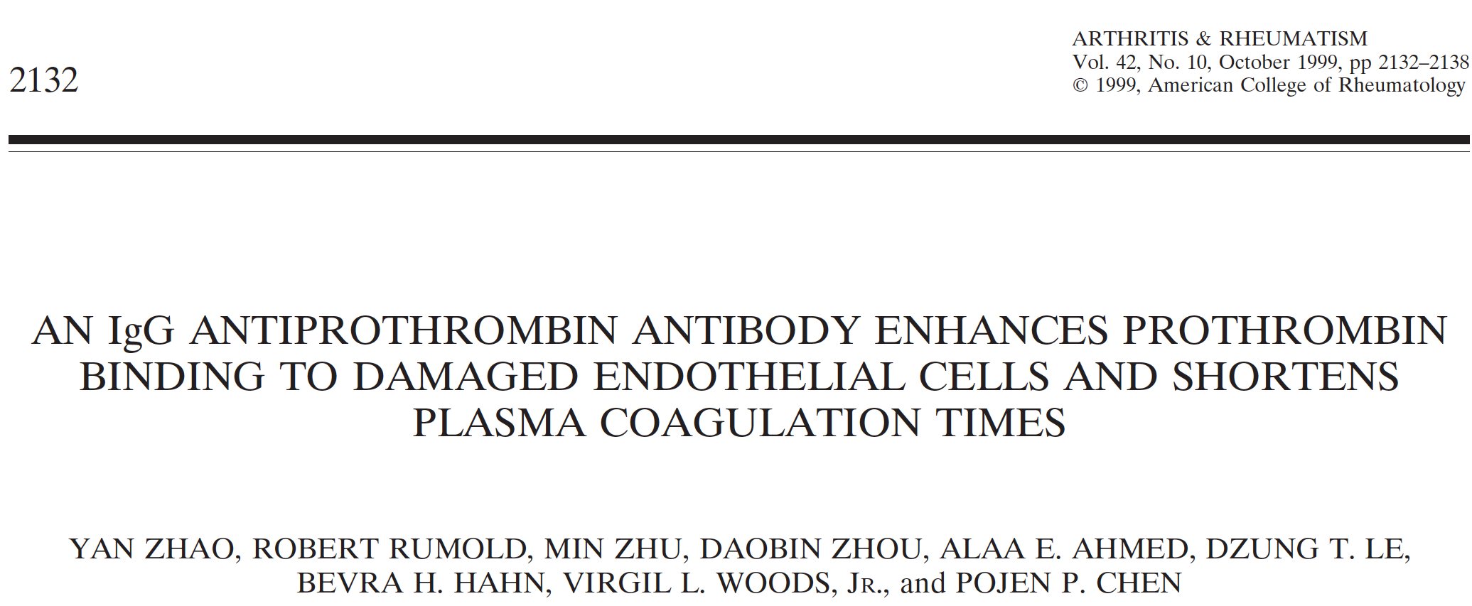
An anti-prothrombin antibody binds to the vessel-lining cells, especially the damaged ones, and is able to bind protrombin bound to such cells
In the presence of anti-prothrombin antibody, the ability of vessel-lining cells to induce coagulation was increased
This study is one of the first to propose a mechanism of action of anti-protrombin antibodies, which make cells lining the blood vessels more prone to trigger blood clots

Slide 14
This original study shows for the first time that many anti-prothrombin antibodies bind the active protein thrombin better than its precursor (prothrombin)
The antibodies make thrombin less sensitive to the action of its natural inhibitor called antithrombin
Heparin is commonly used in the clinic to bring antithrombin to thrombin and thus inhibit blood clotting. Some APL antibodies interfere with the binding of heparin to thrombin.

Slide 15
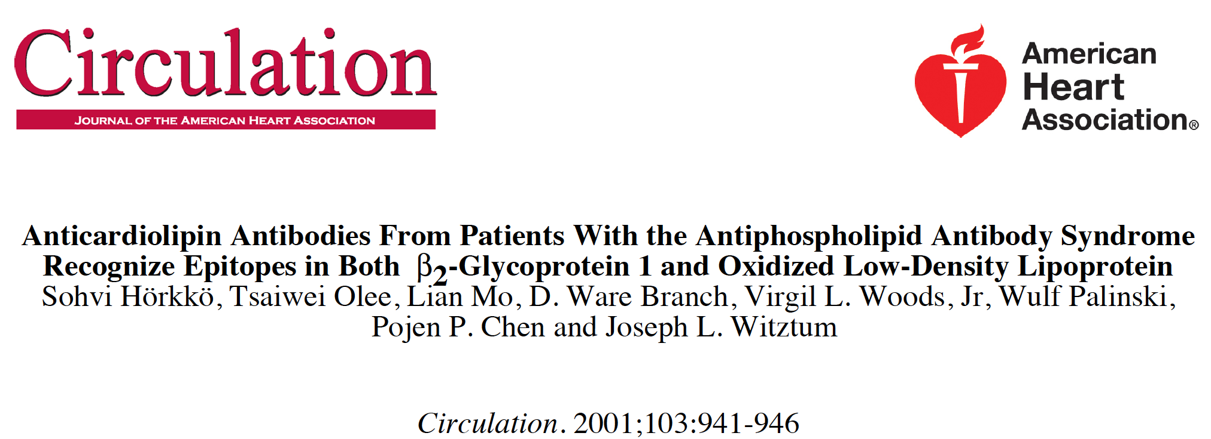
This original study showed that antiphospholipid antibodies react very well against damaged (oxidized) phospholipids and can react against the same damaged lipids that cause heart disease after deposition in the wall of the arteries
This study proposes that counteracting the oxidation of the lipids through antioxidant therapies we could slow down the formation of APL antibodies or avoid their disease-promoting action

Slide 16
Summary I
The antiphospholipid (APL) syndrome is an autoimmune condition characterized by anomalous blood clots and pregnancy problems and caused by the presence of antibodies in the blood called APL antibodies
Blood from Patients with APL syndrome can display paradoxical defects of clotting in test tubes
The mechanism of action of APL antibodies on clotting is complex, however they bind to the cells lining the blood vessels and induce a pro-clotting behavior of these cells
The pregnancy problems are probably not due to blood clotting in the placenta or fetal organs, but rather to direct binding of the antibodies to the placental cells or the blood vessel that nourish the embryo/fetus, which causes dysfunction of these cells.

Slide 17
Summary II
Experiments suggest that the anomalous blood clotting requires the presence of the APL antibodies however a “second hit” (probably an infection) might be necessary in order to trigger the clotting episodes
The main question is what is bound by the APL antibodies. Despite their name, it is clear that only some of them bind phospholipids alone, mostly they are directed against proteins, often proteins that in turn bind to phospholipids
The main candidate target is a protein called beta2GPI whose mechanism of action is still not so clear. Several other targets for antiphospholipid antibodies are known, the most important ones are coagulation proteins
Dr. Woods contributed to seminal work on identification of targets of the APL

