Slide 1
Office of Contract & Grant Administration
New Registration and Proposal Submission Processes for NSF (Research.gov)
May 1, 2018

Slide 2
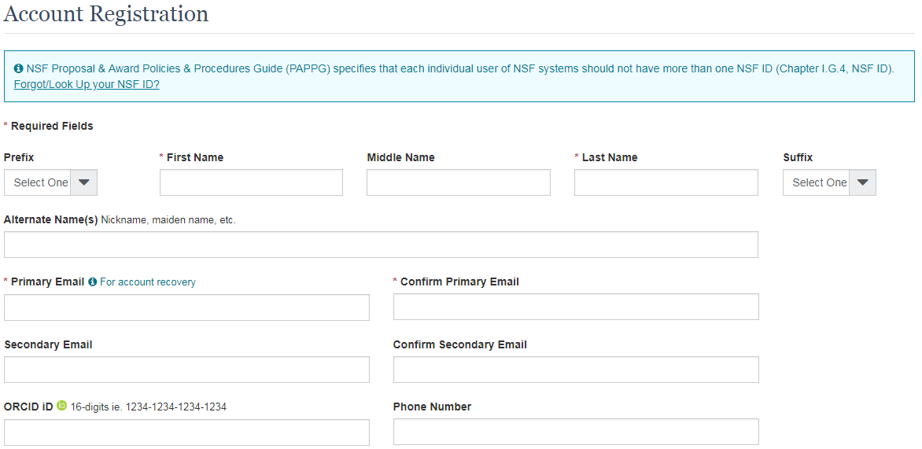
Registration
New NSF user registration process:
Complete the NSF Account Registration Form.

Slide 3
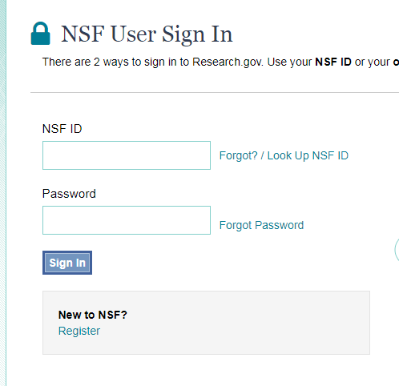
Registration
New NSF user registration process:
2. Use your NSF ID and temporary password to access Research.gov.

Slide 4
Registration
New NSF user registration process:
3. Select the Administrator role.
4. OCGA will re-assign your role to Other Authorized User.
Existing NSF account holders, including Grants.gov and Application Submission Web Service (ASWS) users, will be migrated to the new account management system.
For more information about the NEF registration process, please visit OCGA’s new Blink page on the topic.

Slide 5
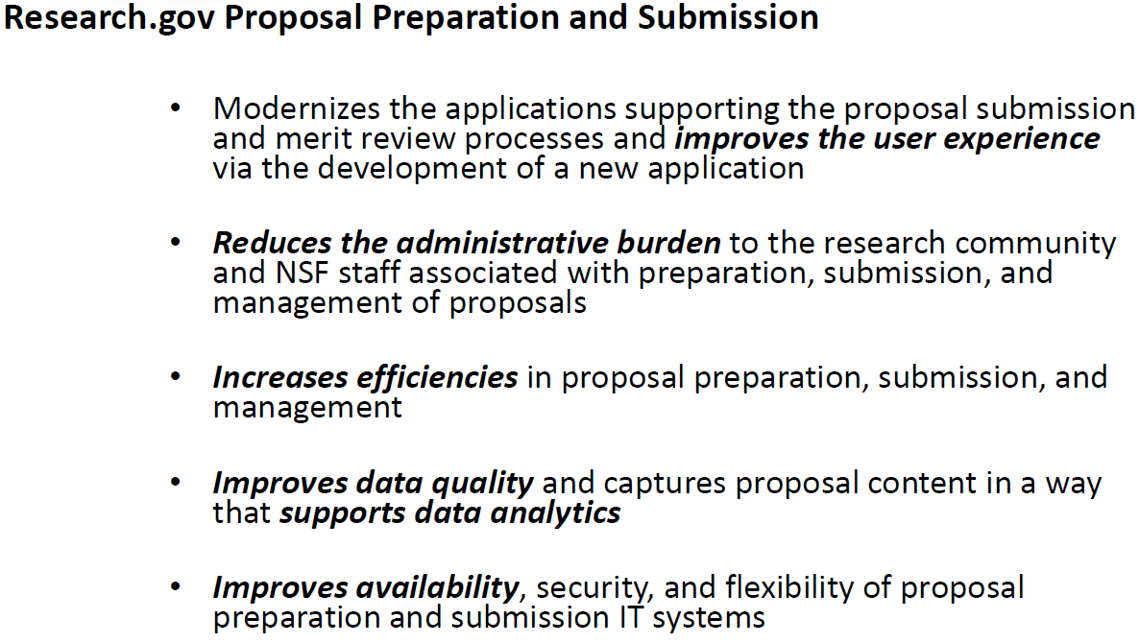
NSF Research.Gov Proposal Submission

Slide 6
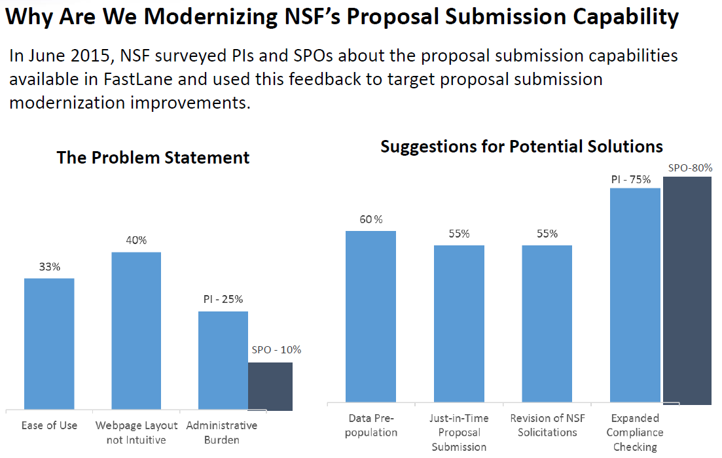
NSF Research.Gov Proposal Submission

Slide 7
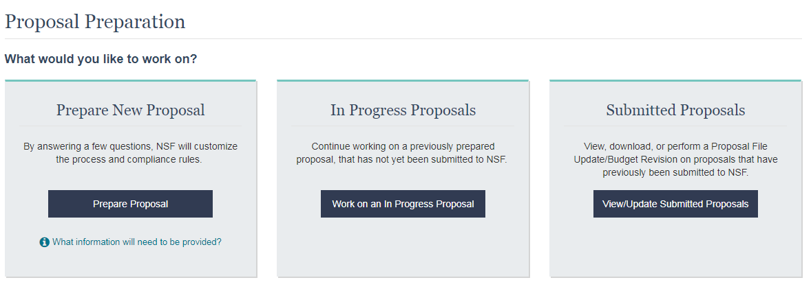
NSF Research.Gov Proposal Submission
For preparing and submitting full research non-collaborative proposals, log into Research.gov.
Click on the Prepare & Submit Proposals tab and then the “New! Prepare Proposals” subtab.

Slide 8
Questions
If you have any questions, please feel free to contact your Contract and Grant Officer.
The OCGA Staff Assignments tool can help you find your Contract and Grant Officer if needed.

