Slide 1
Conflict of Interest (COI) Forms
Jennifer J. Ford
Research Compliance and Integrity
Conflict of Interest Office

Slide 2
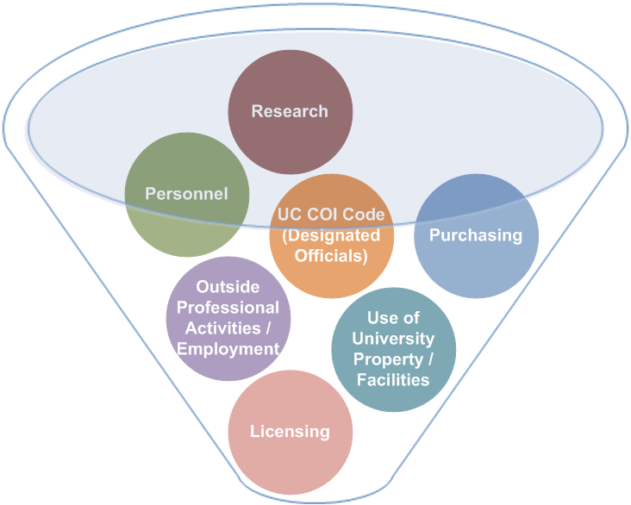
Conflict of Interest (COI) Office
Assists employees in assessing circumstances under which their outside activities or interests may inappropriately conflict with their responsibilities to the University
Seeks to maintain a reasonable balance between competing interests
Promotes transparency and disclosure as a means to identify interests that might bias research
Provides mechanisms to manage the collaborative research partnerships between the Government, the University, and private industry

Slide 3
COI Office Services
Reviews disclosures of financial interests from University faculty and staff
Ensures compliance with all applicable regulations
Serves as a resource to University faculty, staff and institutional offices
When research or other related activities are involved, conflict of interest disclosures of financial interests may be required

Slide 4
What Constitutes a Potential COI?
Income/Payments: Salaries, Consulting, Honoraria, etc.
Position: Founder, Partner, Board of Directors, Scientific Advisory Board, Employee, etc.
Ownership Interest: Stocks, Bonds, Stock Options
Gifts
Loans
Travel Reimbursement/Payments
Intellectual Property
Applies to the Employee, Spouse, Registered Domestic Partner, Dependent Children

Slide 5
What is Subject to COI Disclosure? Research or Other Related Activities
Sponsored Research (Basic, Applied, Animal, Human)
Federal:
NIH and NSF
Other agencies who have adopted the federal requirements including sub-awards
Non-Federal
Non-Profit
For-Profit
Other Related Activities (Non-Federal)
Gifts
Lab Service Agreements (LSA)
Institutional Service/Consulting Agreements (ISA/ICA)
Material Transfer Agreements (MTA)

Slide 6
What to Disclose?
1) Who is the Sponsor? | 2) Which Disclosure Form? | 3) What to Disclose? | Who decides if the research and the interests are related?
Public Health Services (PHS) (i.e. NIH and those who have adopted PHS) | PHS | Disclose all interests related to the discloser’s Institutional Responsibilities* | Institution
Federal Non-PHS (i.e. NSF, CIRM, UC Programs) | 9510 | Disclose any interests related to the work to be conducted under the proposed project | Discloser
Non-Federal (For-Profit or Non-Profit)** | 700U | Disclose any interests with the sponsor(s) | Institution
*Reasonably appears to be related to or is in the same field of expertise as your Institutional Responsibilities.
** Includes research and other related activities (gifts, service agreements, MTAs, unfunded projects, etc.)

Slide 7
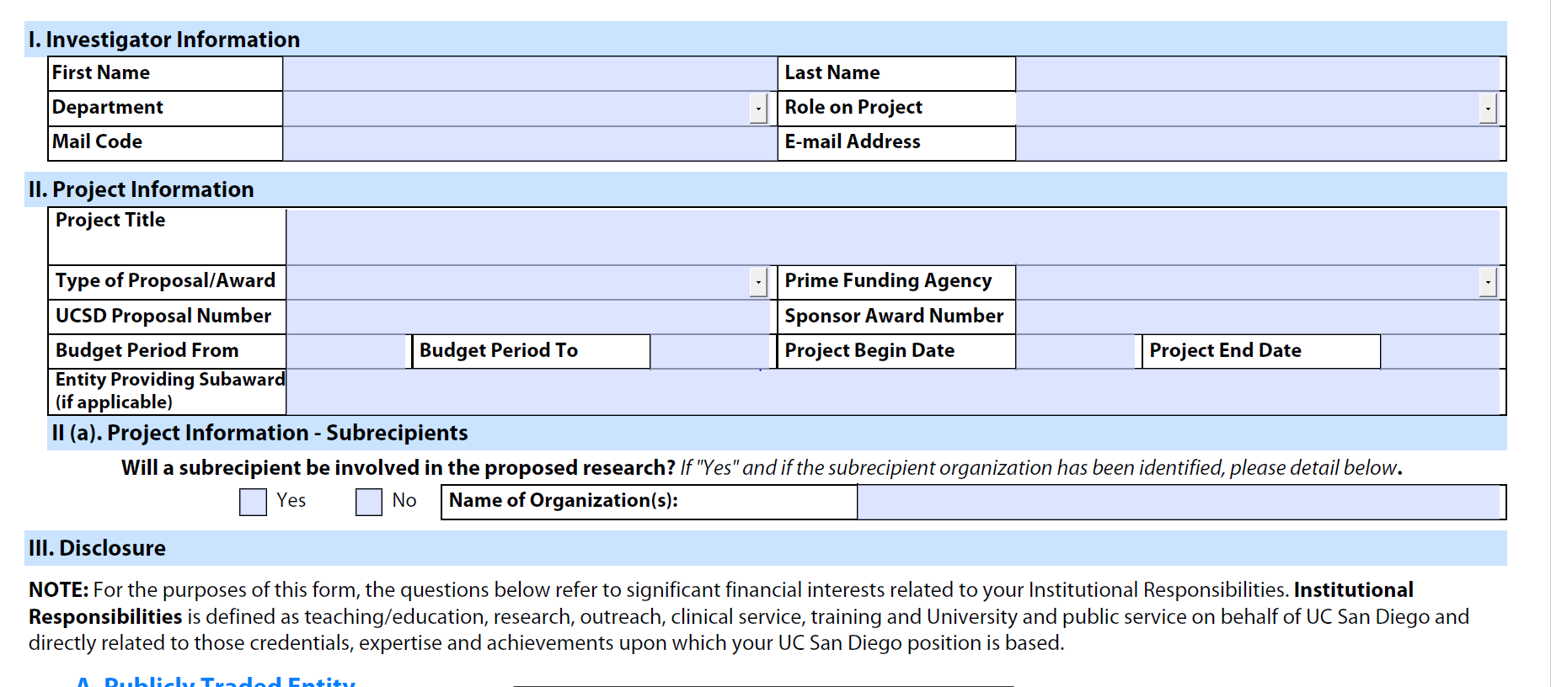
PHS Form

Slide 8
Non-PHS Form (9510)

Slide 9
Non-Federal (700U)

Slide 10
When are disclosures reviewed by COI Office?
Sponsor | Disclosure Form Required with Initial Submission | Additional Form Required if Positive | When does COI Office review?
Public Health Services (PHS) (i.e. NIH and those who have adopted PHS) | PHS form | Supplement | Notice of Award
Federal Non-PHS (i.e. NSF, CIRM, UC Programs) | 9510 | Addendum | Proposal submission
Non-Federal (For-Profit or Non-Profit)** | 700U | Addendum | Proposal submission

Slide 11
COI Contact Information
COI Office Website: http://coi.ucsd.edu Email Questions: info-coi@ucsd.edu Email Forms: coiforms@ucsd.edu Telephone: (858) 534-6465
Jennifer J. Ford, Director, jjford@ucsd.edu

